Slide 1
Search via Quantum Walk
Sharan Krishnan

Slide 2
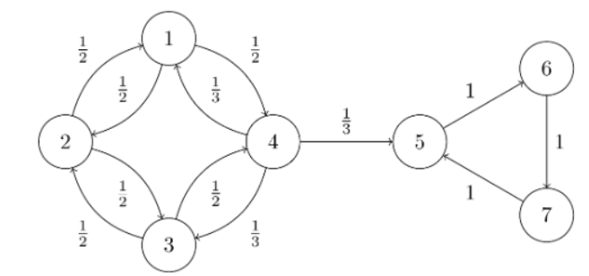


Background: Markov Chains
A Markov chain, denoted $(X_{n})$ is an ordered sequence of samples from a discrete state space $S$, ordered by a discrete time index $n$. Markov chains satisfy the Markov property:
$$P\left(X_{n+1} | X_{n},X_{n−1}…\right)=P(X_{n+1}|X_{n})$$
A time-homogenous Markov chain is one where $P(X_{n+1}|X_{n})$ is independent of time $n$. When the state space is finite, these are best represented as graphs.

Slide 3
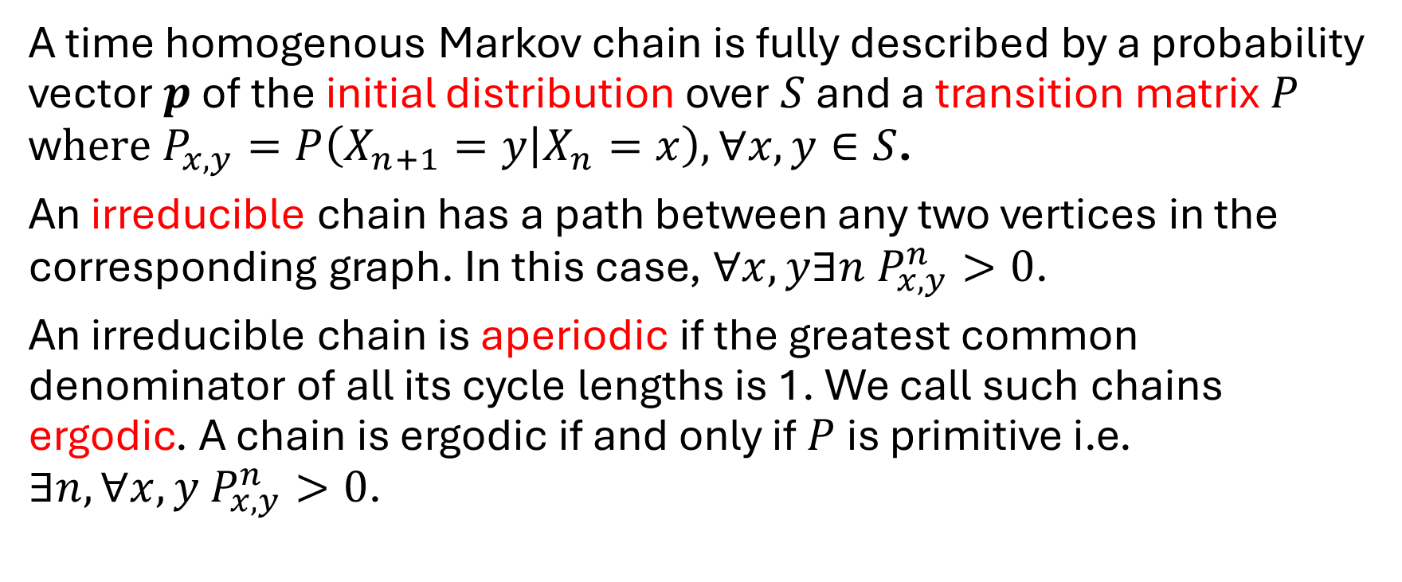
Background: Irreducible and Aperiodic Chains
A time homogenous Markov chain is fully described by a probability vector $p$ of the initial distribution over $S$ and a transition matrix $P$ w$here P_{x,y}=P\left(X_{n+1}=y | X_{n}=x\right),∀x,y∈S$.
An irreducible chain has a path between any two vertices in the corresponding graph. In this case, $∀x,y∃n P_{x,y}^{n}>0$.
An irreducible chain is aperiodic if the greatest common denominator of all its cycle lengths is 1. We call such chains ergodic. A chain is ergodic if and only if $P$ is primitive i.e. $∃n,∀x,y P_{x,y}^{n}>0$.

Slide 4
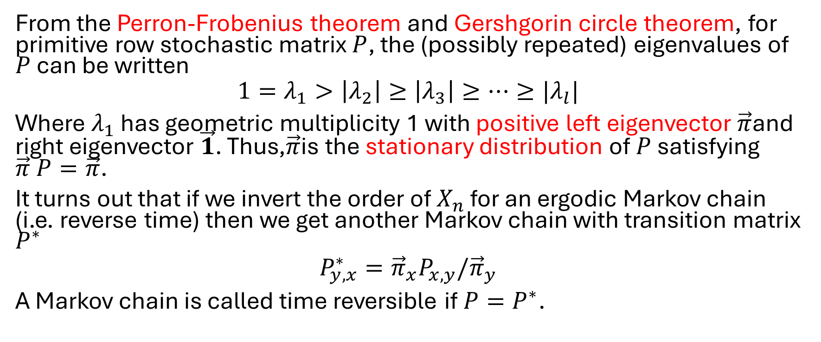
Background: Stationary Distributions and Time Reversible Markov Chains
From the Perron-Frobenius theorem and Gershgorin circle theorem, for primitive row stochastic matrix $P$, the (possibly repeated) eigenvalues of $P$ can be written
$$1=λ_{1}>\left|λ_{2}\right|≥\left|λ_{3}\right|≥…≥|λ_{l}|$$
Where $λ_{1}$ has geometric multiplicity 1 with positive left eigenvector$\vec{π}$and right eigenvector $\vec{1}$. Thus,$\vec{π}$is the stationary distribution of $P$ satisfying $\vec{π} P=\vec{π}$.
It turns out that if we invert the order of $X_{n}$ for an ergodic Markov chain (i.e. reverse time) then we get another Markov chain with transition matrix $P^{∗}$
$$P_{y,x}^{∗}={\vec{π}}_{x}P_{x,y}/{\vec{π}}_{y}$$
A Markov chain is called time reversible if $P=P^{∗}$.

Slide 5
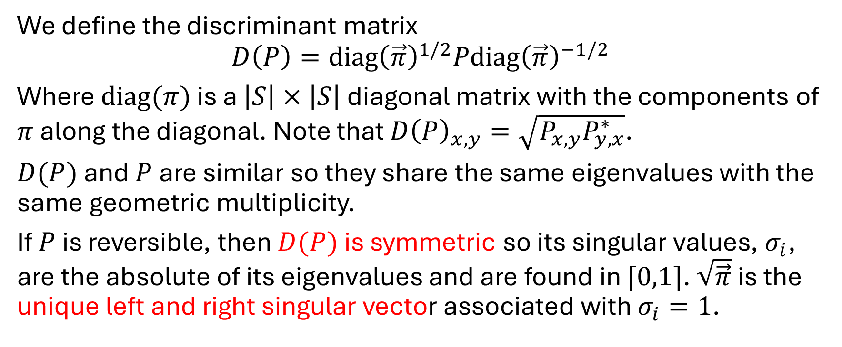
Background: Discriminant Matrix
We define the discriminant matrix
$$D\left(P\right)=diag{\left(\vec{π}\right)}^{1/2}Pdiag{\left(\vec{π}\right)}^{−1/2}$$
Where $diag(π)$ is a $\left|S\right|×\left|S\right|$ diagonal matrix with the components of $π$ along the diagonal. Note that $D{\left(P\right)}_{x,y}=\sqrt{P_{x,y}P_{y,x}^{∗}}$.
$D(P)$ and $P$ are similar so they share the same eigenvalues with the same geometric multiplicity.
If $P$ is reversible, then $D(P)$ is symmetric so its singular values, $σ_{i}$, are the absolute of its eigenvalues and are found in $[0,1]$. $\sqrt{\vec{π}}$ is the unique left and right singular vector associated with $σ_{i}=1$.

Slide 6
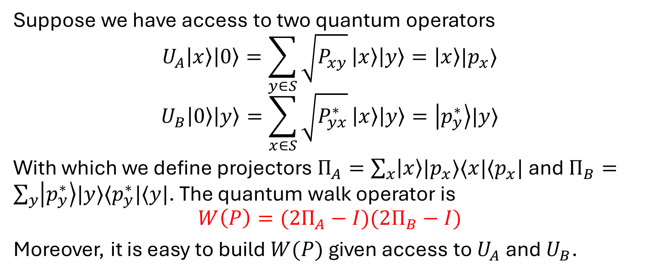
Szegedy’s quantum walk operator I
Suppose we have access to two quantum operators
$$U_{A}\left|x\right\rangle \left|0\right\rangle =\sum_{y∈S}{\sqrt{P_{xy}}}\left|x\right\rangle \left|y\right\rangle =\left|x\right\rangle |p_{x}⟩$$
$$U_{B}\left|0\right\rangle \left|y\right\rangle =\sum_{x∈S}{\sqrt{P_{yx}^{∗}}}\left|x\right\rangle \left|y\right\rangle =\left|p_{y}^{∗}\right\rangle |y⟩$$
With which we define projectors $Π_{A}=\sum_{x}{\left|x\right\rangle |p_{x}⟩⟨x|⟨p_{x}|}$ and $Π_{B}=\sum_{y}{\left|p_{y}^{∗}\right\rangle |y⟩⟨p_{y}^{∗}|⟨y|}$. The quantum walk operator is
$$W\left(P\right)=(2Π_{A}−I)(2Π_{B}−I)$$
Moreover, it is easy to build $W(P)$ given access to $U_{A}$ and $U_{B}$.

Slide 7
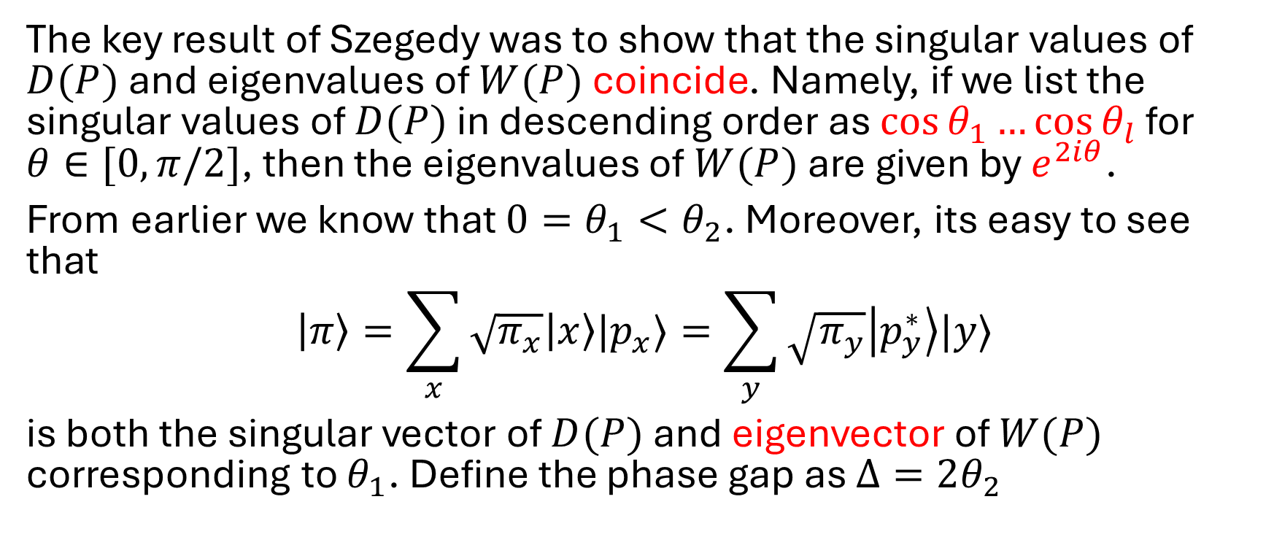
Szegedy’s quantum walk operator II
The key result of Szegedy was to show that the singular values of $D(P)$ and eigenvalues of $W(P)$ coincide. Namely, if we list the singular values of $D(P)$ in descending order as $\cos{θ_{1}}…\cos{θ_{l}}$ for $θ∈[0,π/2]$, then the eigenvalues of $W(P)$ are given by $e^{2iθ}$.
From earlier we know that $0=θ_{1}<θ_{2}$. Moreover, its easy to see that
$$\left|π\right\rangle =\sum_{x}{\sqrt{π_{x}}\left|x\right\rangle |p_{x}⟩}=\sum_{y}{\sqrt{π_{y}}\left|p_{y}^{∗}\right\rangle |y⟩}$$
is both the singular vector of $D(P)$ and eigenvector of $W(P)$ corresponding to $θ_{1}$. Define the phase gap as $Δ=2θ_{2}$

Slide 8
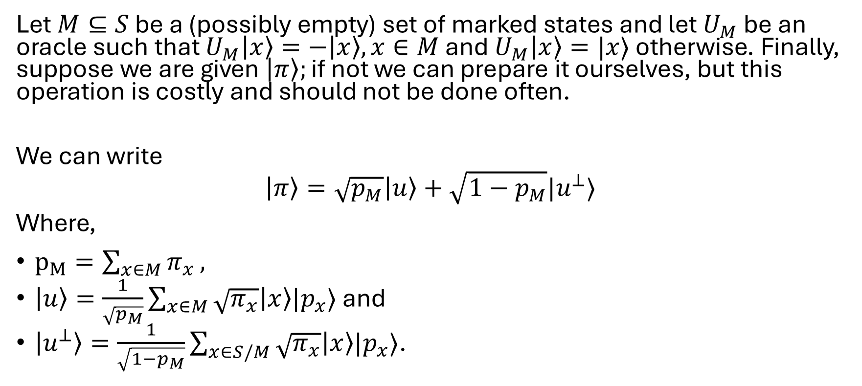
High level search algorithm I
Let $M⊆S$ be a (possibly empty) set of marked states and let $U_{M}$ be an oracle such that $U_{M}\left|x\right\rangle =−\left|x\right\rangle , x∈M$ and $U_{M}\left|x\right\rangle =|x⟩$ otherwise. Finally, suppose we are given $\left|π\right\rangle ;\text{if} \text{not} \text{we} \text{can} \text{prepare} \text{it} \text{ourselves}\text{, }\text{but} \text{this} \text{operation} \text{is} \text{costly} \text{and} \text{should} \text{not} \text{be} \text{done} \text{often}\text{.}$
We can write
$$\left|π\right\rangle =\sqrt{p_{M}}\left|u\right\rangle +\sqrt{1−p_{M}}|u^{⊥}⟩$$
Where,
$p_{M}=\sum_{x∈M}{π_{x}},$
$\left|u\right\rangle =\frac{1}{\sqrt{p_{M}}}\sum_{x∈M}{\sqrt{π_{x}}\left|x\right\rangle |p_{x}⟩}$ and
$\left|u^{⊥}\right\rangle =\frac{1}{\sqrt{1−p_{M}}}\sum_{x∈S/M}{\sqrt{π_{x}}\left|x\right\rangle |p_{x}⟩}$.

Slide 9
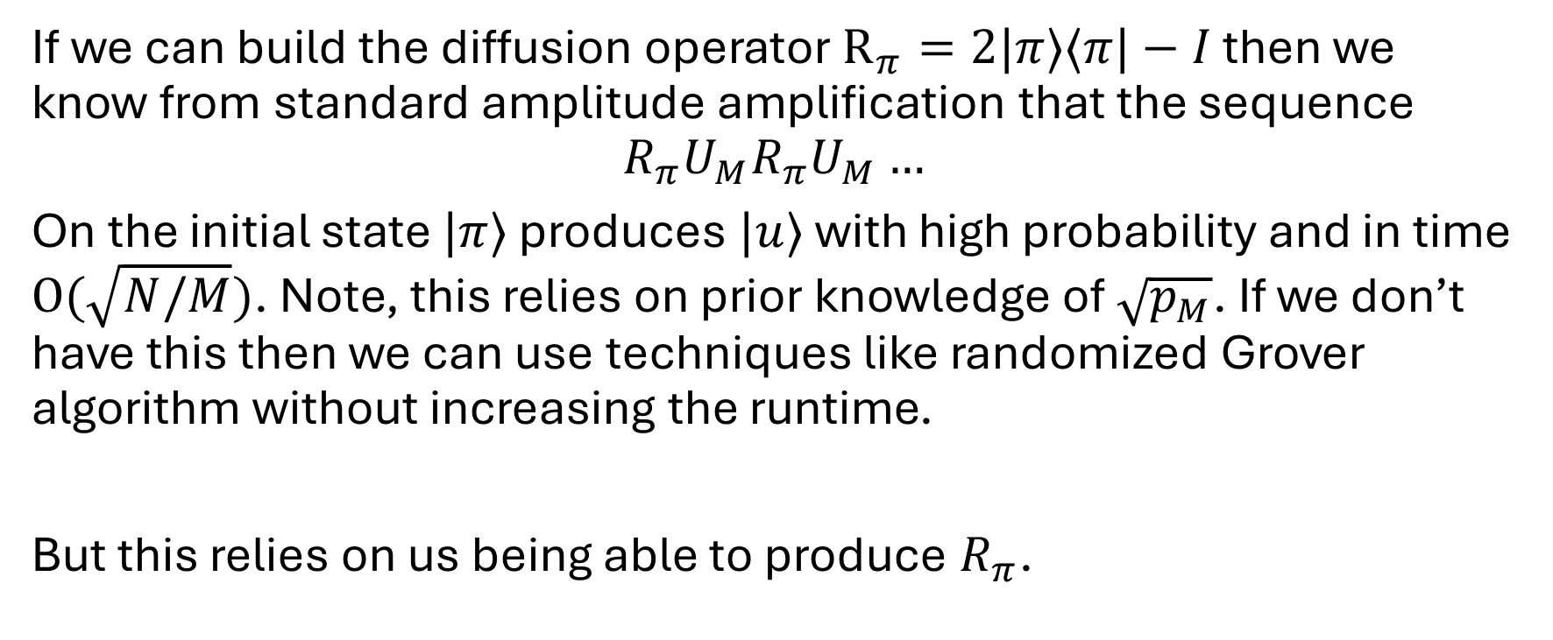
High level search algorithm II
If we can build the diffusion operator $R_{π}=2|π⟩⟨π|−I$ then we know from standard amplitude amplification that the sequence
$$R_{π}U_{M}R_{π}U_{M}…$$
On the initial state $|π⟩$ produces $|u⟩$ with high probability and in time $O(\sqrt{N/M})$. Note, this relies on prior knowledge of $\sqrt{p_{M}}$. If we don’t have this then we can use techniques like randomized Grover algorithm without increasing the runtime.
But this relies on us being able to produce $R_{π}$.

Slide 10
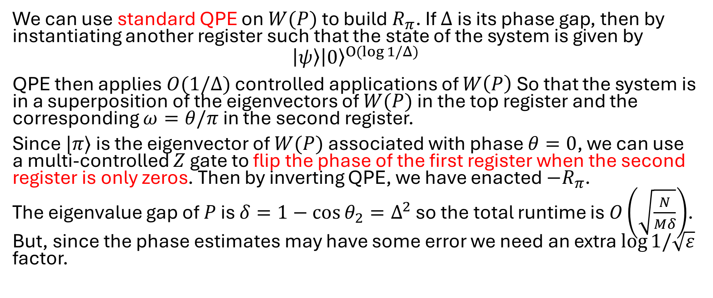
Building the diffusion operator
We can use standard QPE on $W(P)$ to build $R_{π}$. If $Δ$ is its phase gap, then by instantiating another register such that the state of the system is given by
$$\left|ψ\right\rangle {\left|0\right\rangle }^{O(log{1/Δ})}$$
QPE then applies $O(1/Δ)$ controlled applications of $W\left(P\right)$ So that the system is in a superposition of the eigenvectors of $W(P)$ in the top register and the corresponding $ω=θ/π$ in the second register.
Since $|π⟩$ is the eigenvector of $W(P)$ associated with phase $θ=0$, we can use a multi-controlled $Z$ gate to flip the phase of the first register when the second register is only zeros. Then by inverting QPE, we have enacted $−R_{π}$.
The eigenvalue gap of $P$ is $δ=1−\cos{θ_{2}}=Δ^{2}$ so the total runtime is $O\left(\sqrt{\frac{N}{Mδ}}\right)$. But, since the phase estimates may have some error we need an extra $\log{1/\sqrt{ε}}$ factor.

Slide 11
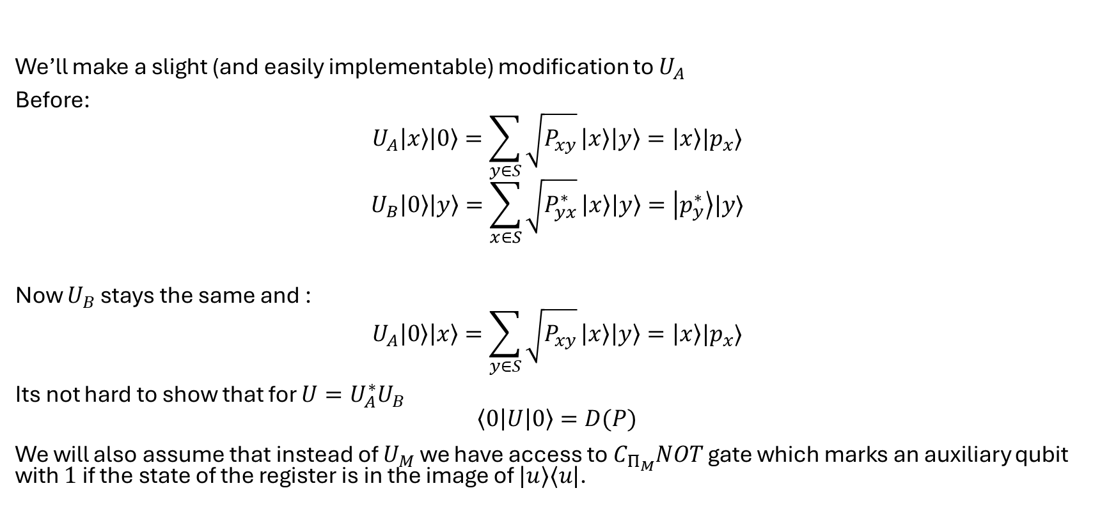
Search via QSVT: Assumptions
We’ll make a slight (and easily implementable) modification to $U_{A}$
Before:
$$U_{A}\left|x\right\rangle \left|0\right\rangle =\sum_{y∈S}{\sqrt{P_{xy}}}\left|x\right\rangle \left|y\right\rangle =\left|x\right\rangle |p_{x}⟩$$
$$U_{B}\left|0\right\rangle \left|y\right\rangle =\sum_{x∈S}{\sqrt{P_{yx}^{∗}}}\left|x\right\rangle \left|y\right\rangle =\left|p_{y}^{∗}\right\rangle |y⟩$$
Now $U_{B}$ stays the same and :
$$U_{A}\left|0\right\rangle \left|x\right\rangle =\sum_{y∈S}{\sqrt{P_{xy}}}\left|x\right\rangle \left|y\right\rangle =\left|x\right\rangle |p_{x}⟩$$
Its not hard to show that for $U=U_{A}^{∗}U_{B}$
$$\left\langle 0\left|U\right|0\right\rangle =D(P)$$
We will also assume that instead of $U_{M}$ we have access to $C_{Π_{M}}NOT$ gate which marks an auxiliary qubit with $1$ if the state of the register is in the image of $|u⟩⟨u|$.

Slide 12
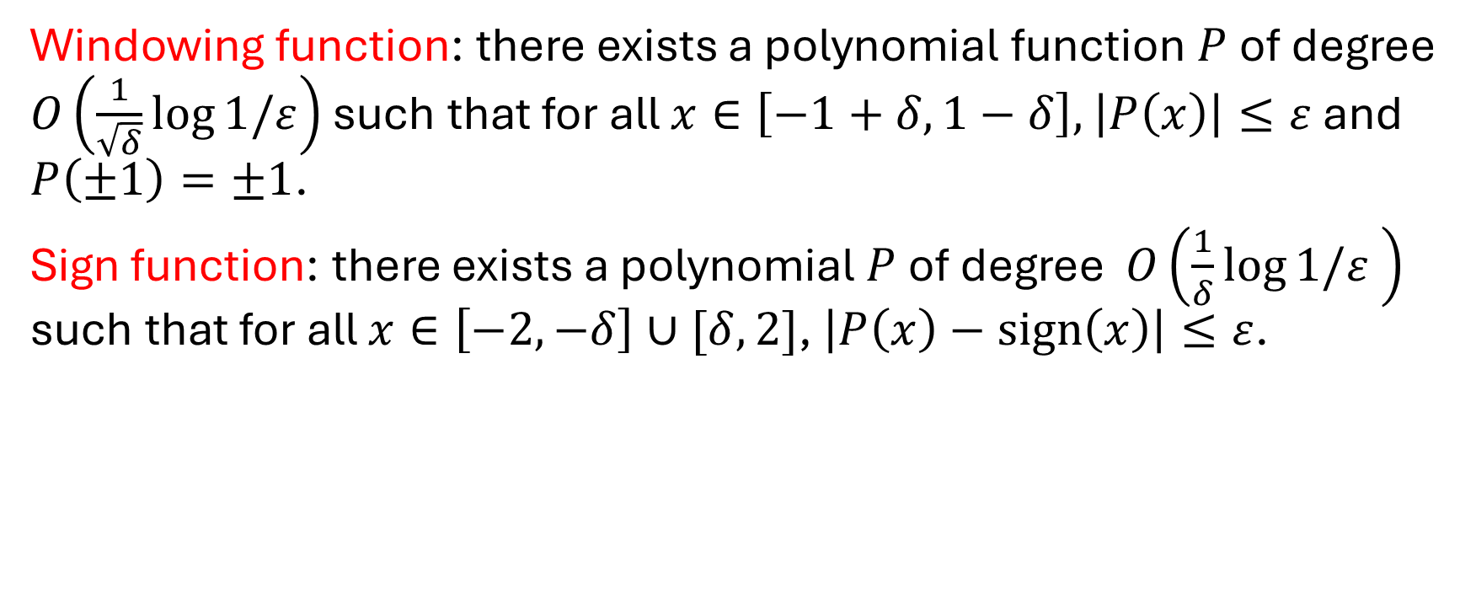
Search via QSVT: Useful Polynomials
Windowing function: there exists a polynomial function $P$ of degree $O\left(\frac{1}{\sqrt{δ}}\log{1/ε}\right)$ such that for all $x∈\left[−1+δ,1−δ\right],$ $\left|P\left(x\right)\right|≤ε$ and $P\left(±1\right)=±1$.
Sign function: there exists a polynomial $P$ of degree $O\left(\frac{1}{δ}\log{1/ε} \right)$ such that for all $x∈\left[−2,−δ\right]∪[δ,2]$, $\left|P\left(x\right)−sign\left(x\right)\right|≤ε$.

Slide 13
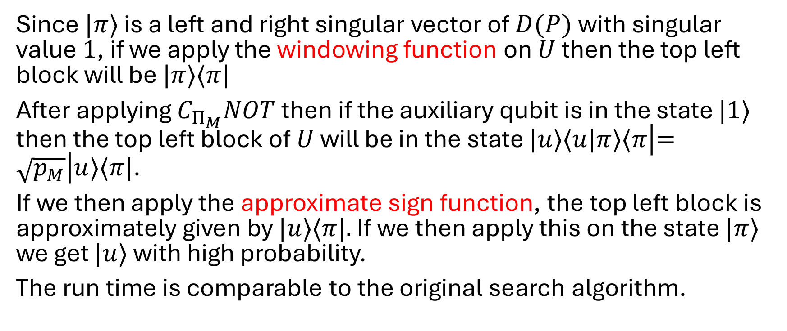
Search via QSVT: the Algorithm
Since $|π⟩$ is a left and right singular vector of $D(P)$ with singular value $1$, if we apply the windowing function on $U$ then the top left block will be $|π⟩⟨π|$
After applying $C_{Π_{M}}NOT$ then if the auxiliary qubit is in the state $|1⟩$ then the top left block of $U$ will be in the state $|u⟩⟨u|π⟩⟨π\left|=\sqrt{p_{M}}\right|u⟩⟨π|$.
If we then apply the approximate sign function, the top left block is approximately given by $|u⟩⟨π|.$ If we then apply this on the state $|π⟩$ we get $|u⟩$ with high probability.
The run time is comparable to the original search algorithm.

Slide 14
Further work
The previous algorithm does not provide a quadratic speedup in finding a marked element in a graph.
The papers
“Quantum Walks can find a Marked Element on Any Graph” (2016)
“Quadratic speedup for finding marked vertices by Quantum Walks” (2020)
“Quantum walk-based search algorithms with multiple marked vertices” (2022)
All build on each other and the work presented here.

